Slide 1
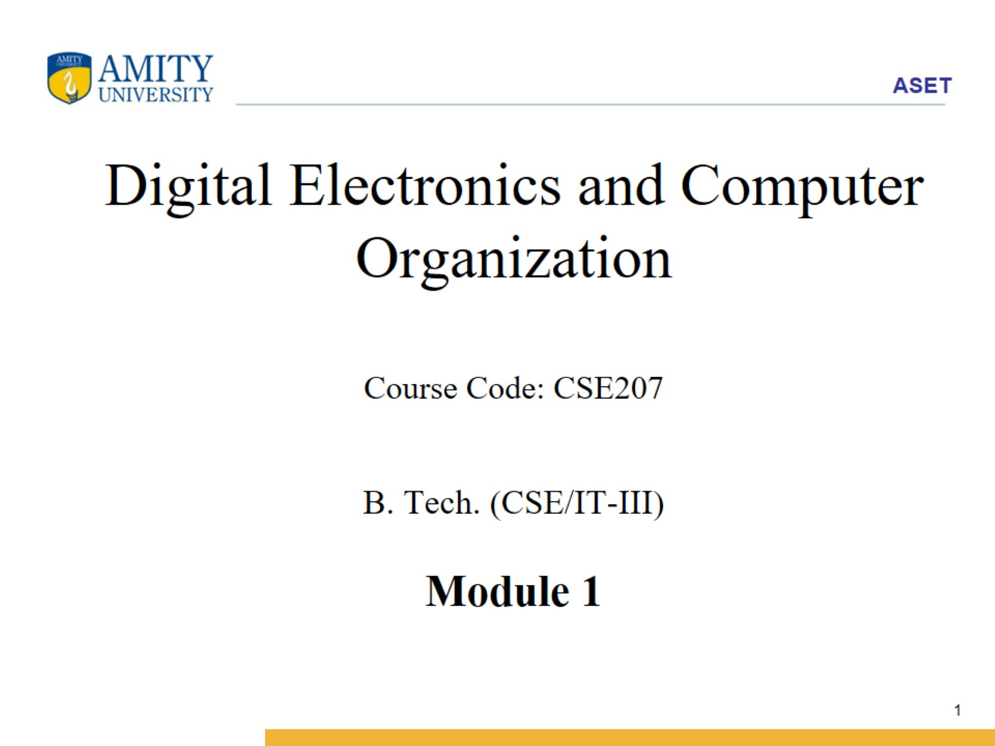
Digital Electronics and Computer Organization Course Code: CSE207 B. Tech. (CSE/IT-III) Module 1

Slide 2
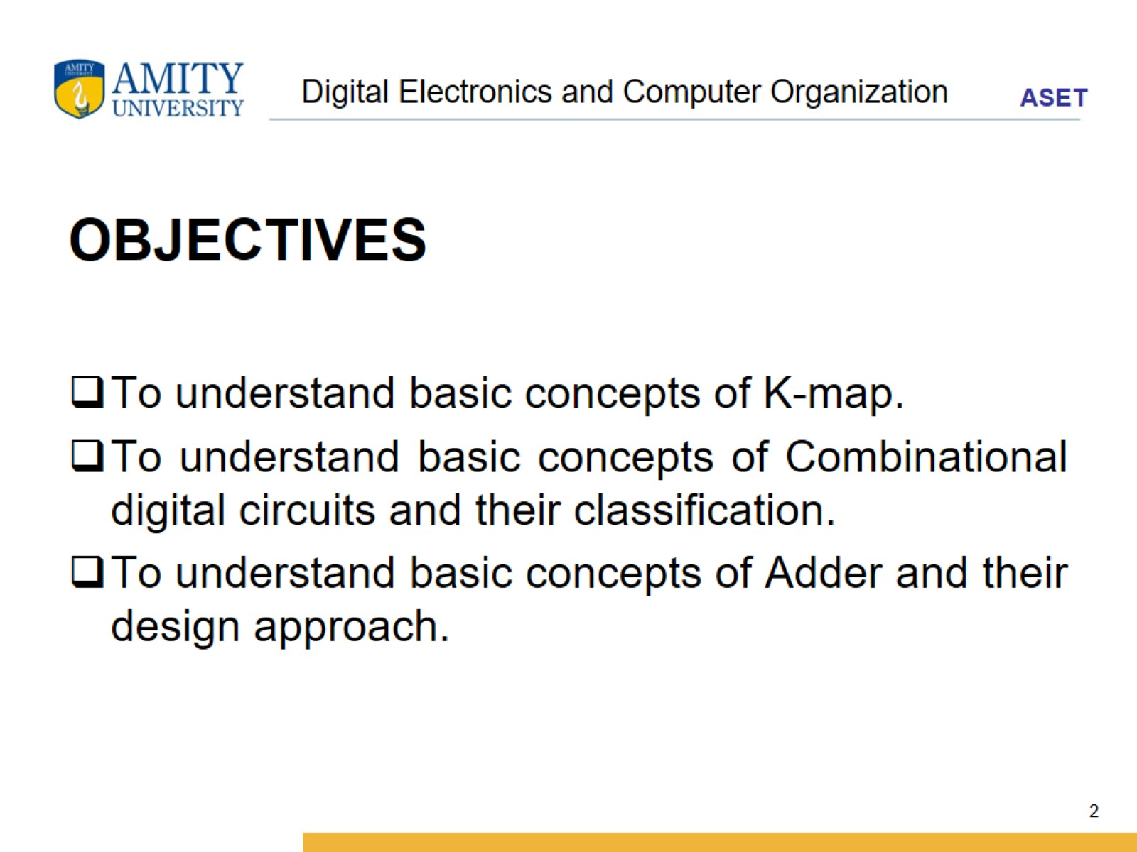
Digital Electronics and Computer Organization

Slide 3
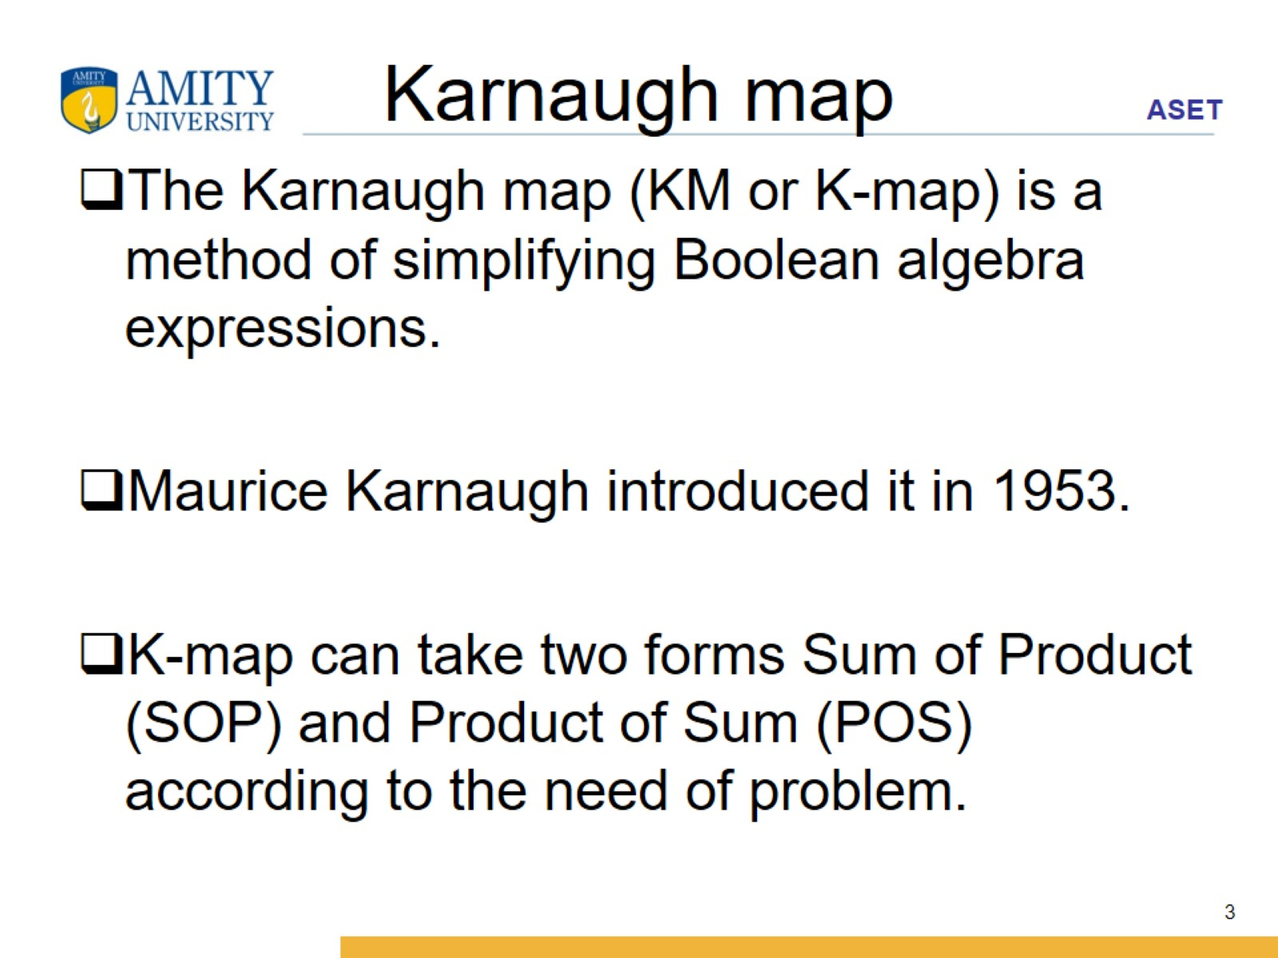
Karnaugh map

Slide 4
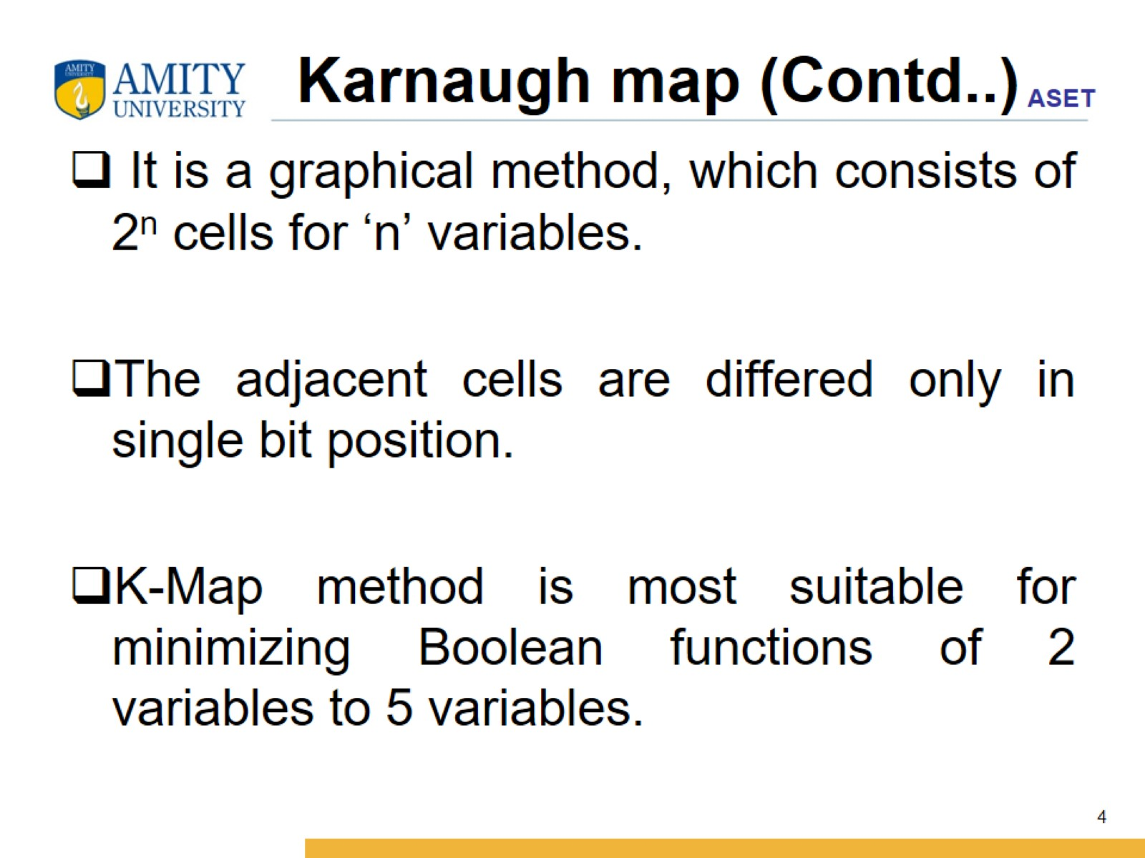
Karnaugh map (Contd..)

Slide 5
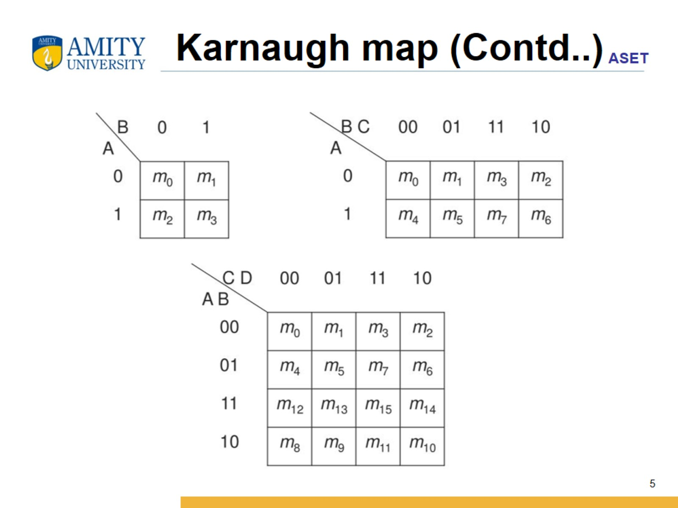
Karnaugh map (Contd..)

Slide 6
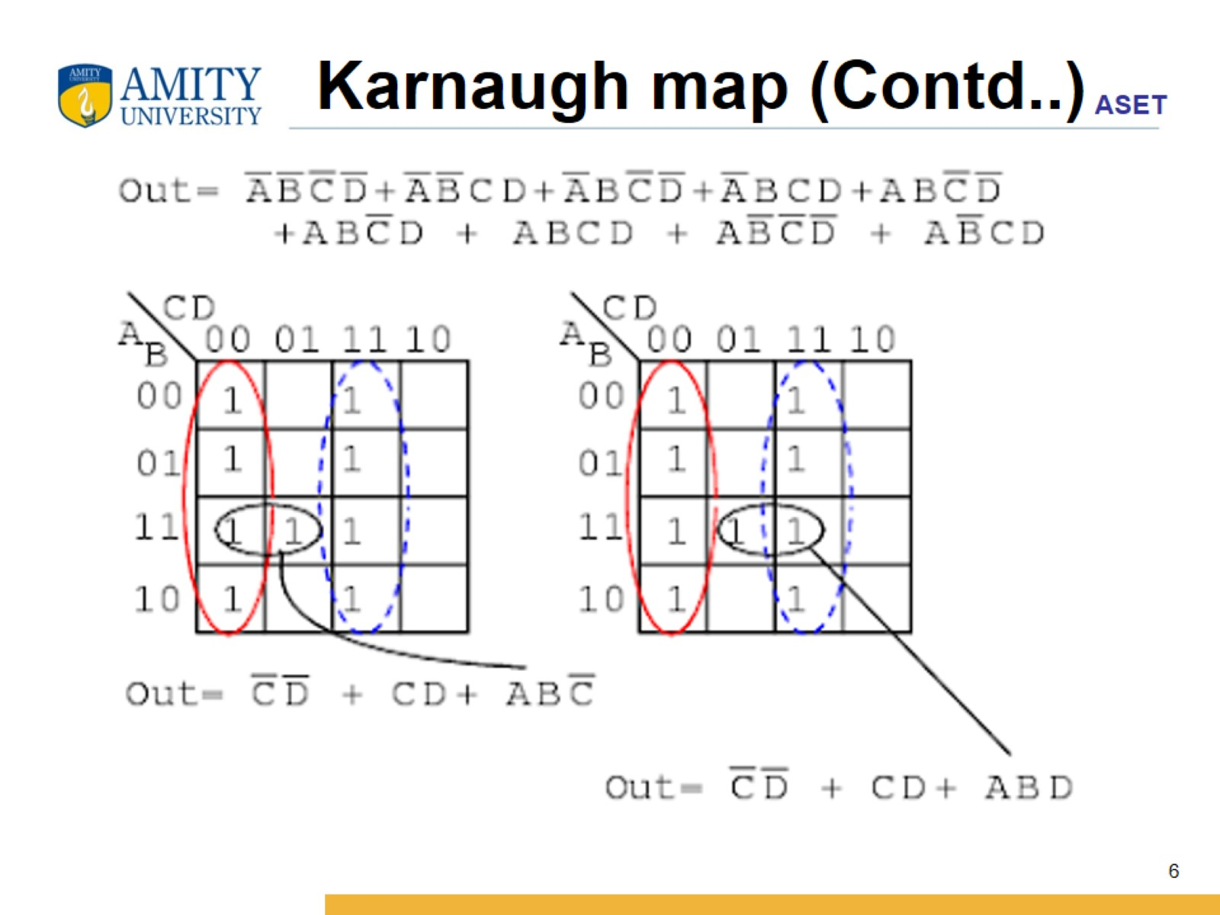
Karnaugh map (Contd..)

Slide 7
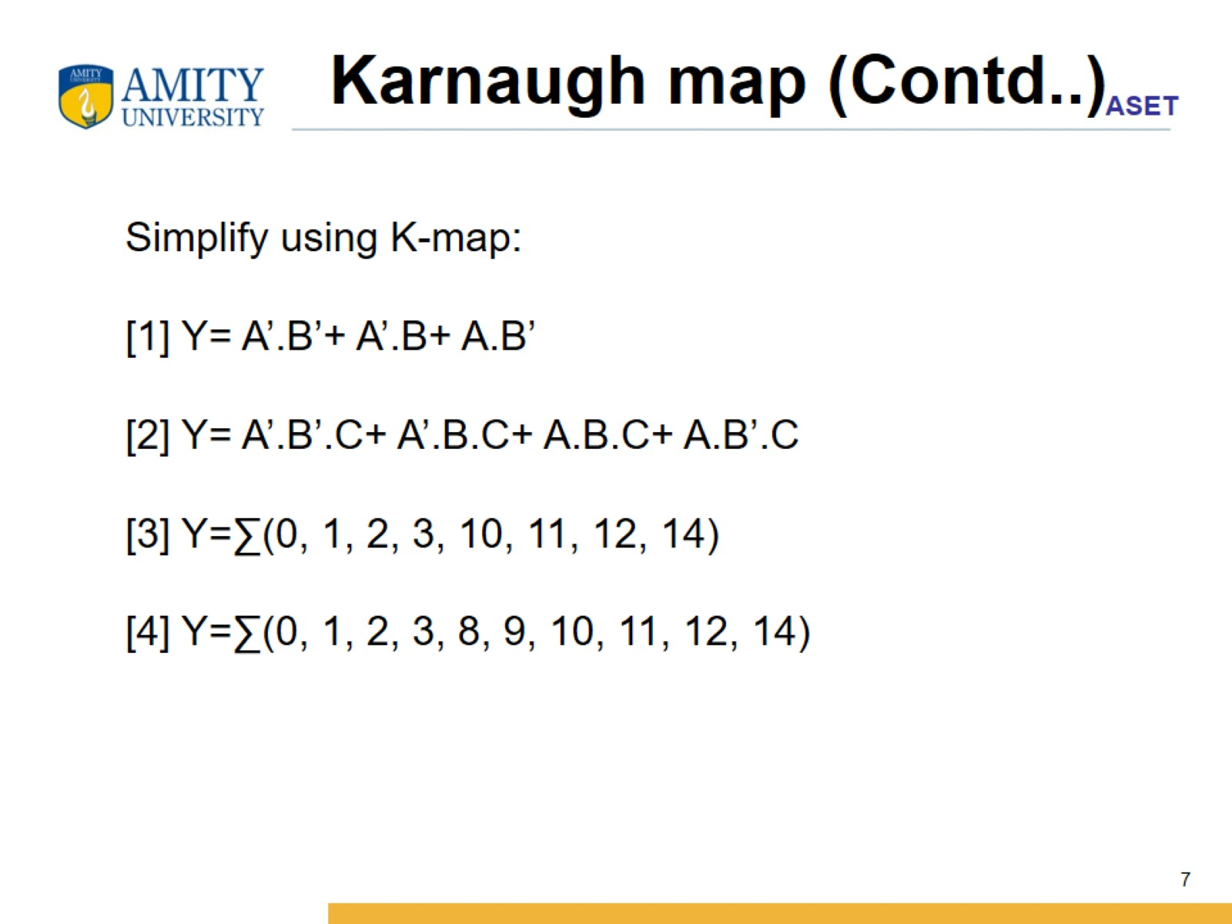
Karnaugh map (Contd..)

